Slide 1


SG EUROPEAN PHARMACEUTICAL
PRICING NERVE CENTRE

Slide 2
ABOUT SIGYN R&D
Sigyn R&D is a Croatian company based in Zagreb, established in 2010.
Tailor made software solutions produced for the pharmaceutical sector.
“Integrated IT System for Drug Market Regulation” currently officially in use by market regulators in two EU Countries: Slovenia and Croatia
  Automated international price referencing for all reimbursed products according to route of administration, pack size, strength, type and other pack content variables in Croatia and Slovenia between Germany, Austria, France, Czech Republic, Italy and Spain;
  Automated internal price referencing based on therapeutic value according to route of administration, pack size, strength, type and other pack content variables;
  Flexible reporting and statistical analyses of pharmaceutical expenditure &
  Integrated process management from application to regulator to drug listing.
Sigyn R&D also uses the software to predict future prices of reimbursed drugs and produce complex pricing scenarios for pharmaceutical companies

Slide 3
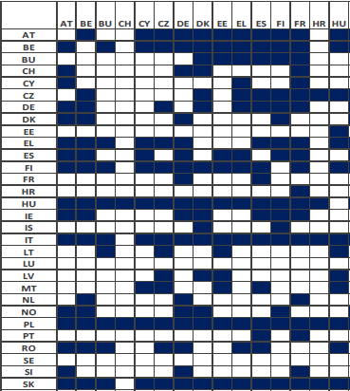
TRANSNATIONAL PRICING
International reference pricing (IRP), internal pricing comparisons, discounts, pay back agreements, reimbursed prices, copayments and managed entry agreements have become highly multivariate, heavily interlinked between countries and confusingly complex.
Managing transnational pharmaceutical pricing in Europe is contingent upon comprehensive, detailed and timely monitoring of national prices, pricing policies and their implementation.

Slide 4
SG EUROPEAN PHARMACEUTICAL
PRICING NERVE CENTRE
Enables companies to have an in depth yet clear and manageable overview of all past and present prices, discounts and agreements as well as their trends across countries for selected own and competitor products. Price comparisons are available by pack, unit, DDD, etc.
Acts as a powerful pricing knowledge management tool and enables effective communication with local affiliates reporting in structure on current pricing rules, expected policy changes, implementation, timing, delays of price calculations, etc.
Based on national rules, the IT solution enables calculation of future prices in real time.
Coupled with sales estimates, the IT solution enables forecasting of income by country.

Slide 5
DATABASE & OPTIONS
The level of access to information for all locations that have access to the software is managed by the HQ.
All entries to the database are recorded.
Option A – Tool to provide structure & clarity
The database of prices, regulation rules and sales figures is designed to be populated manually by employees from affiliate locations. Data for price calculation are exported in chosen format and then reimported in the database after calculations. All data is to be entered for own and competitor products of interest.
Option B – Tool to provide structure & clarity + automation and service
The database of prices and sales figures is populated automatically (prices imported from chosen sources). Price calculations are automated based on defined rules. All data collected automatically for own and competitor products of interest.

Slide 6
M1: PRICE MONITOR
PAST AND PRESENT PRICES FOR ALL MEDICINES OF INTEREST
  own and competitor (comparisons by pack, according to route of administration, pack size, strength, type and other pack content variables). Registered data on prices can include ex-factory prices, pharmacy purchasing (wholesale) prices, pharmacy retail prices, reimbursed prices and copayments, etc.
HISTORY
  dates on which the prices have been altered and explanations why
ALL OTHER RELEVANT DATA
  additional information on individual medicines such as discounts, managed entry agreements, etc.
DYNAMIC VISUAL PRESENTATION
  dynamic visual presentation of all national prices.

Slide 7
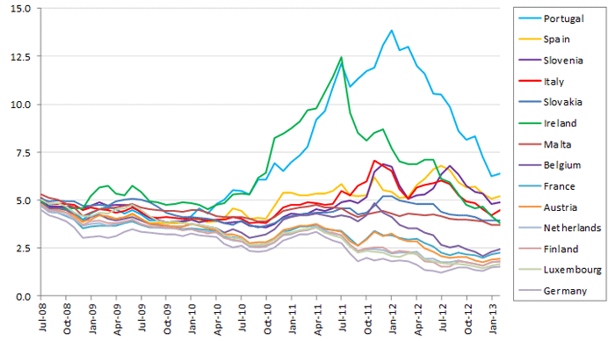
Price of DDD of medicine X, pack Y (28-30 tablets), in 14 selected European countries from July 2008 to January 2013 in EUR

Slide 8
M2: PRICE INTELLIGENCE
NATIONAL REGULATION PROCEDURES
  detailed structured national price setting regulations and timings that apply in the calculation of prices for new medicines and recalculation of prices for medicines already present in the market: international price comparisons, internal price comparisons, mandatory/optional discounts/rebates, managed entry agreements, etc., - all interlinked to individual packs
TIMING AND CONTEXT
  estimates on when particular price setting regulations are to be implemented (and when they should be legally implemented), how stringent the authorities are expected to be in adhering to regulations in implementing price cuts including concessions that could be achieved in price negotiations,
REAL TIME
  intelligence gathering tool for relevant information from local affiliates operating in real time
DYNAMIC VISUAL PRESENTATION
  dynamic visual presentation of price interrelations between countries.

Slide 9
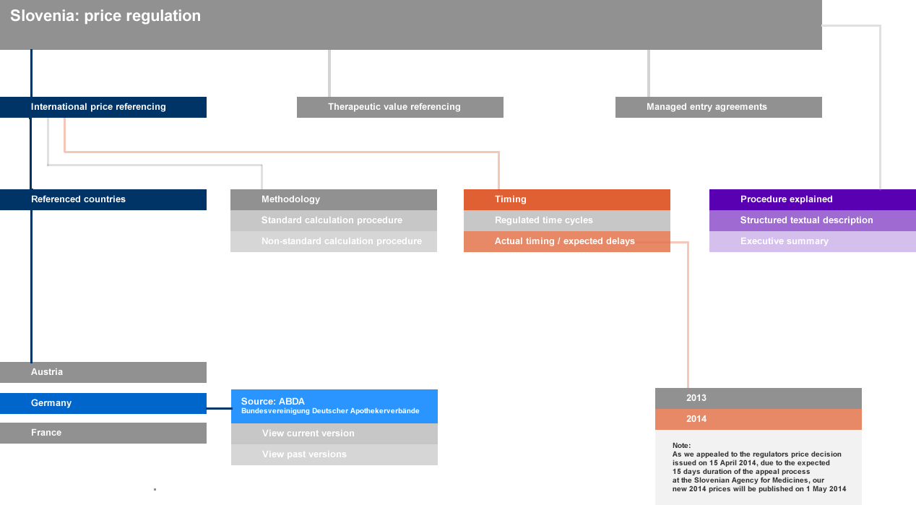
Structured country price regulations: Slovenia

Slide 10
M3: PRICE & INCOME PREDICTOR
INTERNATIONAL PRICE CALCULATIONS
  OPTION A: export of all data required for the calculation of future prices according to national regulation (prices from referenced countries, etc.)
  OPTION B: automatic calculation
OTHER PRICING EVENTS
  OPTION A: export of all data required for the calculation of other pricing events (regulation such as internal price referencing, discounts, etc.) determining final listed prices,
  OPTION B: automatic calculation
TIMING TAKEN INTO ACCOUNT
  Due to overlapping time cycles of price calculations in countries that reference each other
DYNAMIC VISUAL PRESENTATION
  Dynamic visual presentation of price interrelations between countries.

Slide 11
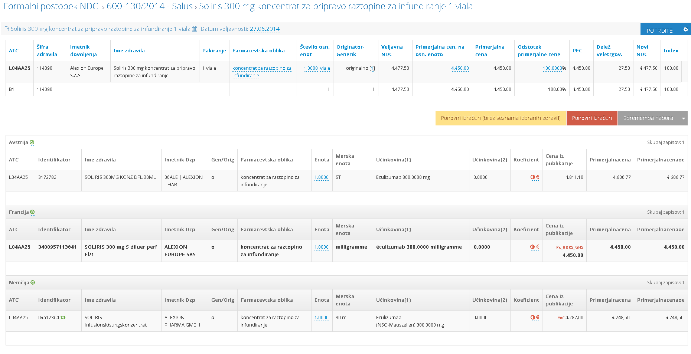
Slovenian calculation procedure based on current Austrian, French and German prices

Slide 12
M4: LAUNCH SEQUENCE CREATOR
INFORMED DECISION MAKING
  The module allows, based on data entered in modules 1, 2 and 3, for testing various launch sequence scenarios by countries for new medicines, quantifying the effects of future cross country price comparisons on national prices and income.
COMPETITOR PRICES TAKEN INTO ACCOUNT
  Overview of competitor medicines and their prices over time in all countries generated.

Slide 13
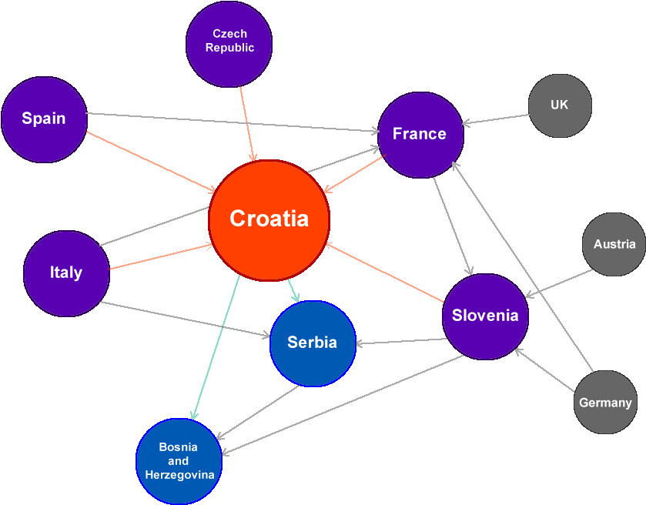
Transnational price referencing relations displayed in dynamic visual presentation, subset of countries, Croatia centred selection

Slide 14
USE, REPORTING & TRAINING
Simple, easy to use, intuitive solution
Individual users can only access the areas of the program that suit their level of authorization
1 day training programme guarantees proficiency in use
Ad hoc automated tailor made reports available as requested
Periodic automated tailor made reports available in-programme
Automatic report/ news dissemination by email available

Slide 15
TECHNICAL & SECURITY
The software solution is based on the Client – Server work technology.
The application can be placed (option) on a specially configured Blackbox server and client access is controlled by security protocols.
Clients access the server using a newer generation web browser
The only special installation required on the client’s computer is a protocol and an authentication certificate to access the server.
We implement the highest safety standards to make sure that your sensitive data is always secure.

